Slide 1

PENETRATION TESTING

Slide 2
Advanced user management

Slide 3
Outline
Advanced access control mechanisms
Advanced policy systems and monitoring
Windows user management

Slide 4
Alternative Access Control Systems
As we already discussed, UNIX’s bitmasks are not so expressive
Can only represent basic rules
Many systems need more expressive security policies
This is particularly relevant in certain contexts such as military installations or industries

Slide 5
POSIX Access Control Lists in Linux
An ACL define the permissions of each user on each file, one by one
There are several implementations of ACL, Linux systems use the POSIX ACL
Defined by a workgroup from 2002
ACL require a type of filesystem that supports them
POSIX ACL are supported by ext2, ext3 e ext4 (common in Linux) as well as by NFS (Solaris)
ACL may be enabled when mounting the filesystem, e.g. with
mount -t ext3 -o acl /dev/device /mnt/partition

Slide 6
POSIX ACL Usage
Even when POSIX ACL are active chmod can be used to handle the bitmasks
But this will affect the content of some entries in the ACL
Clearly there are also dedicated commands to manage the ACL
getfacl: shows the POSIX ACL associated with a file or directory
setfacl: modifies the POSIX ACL associated with a file or directory

Slide 7
Structure of a POSIX ACL
Command getfacl fileORdir shows ACL in this format
#header users rules groups rules mask others rule default rule
We can also print the ACL as a table with getfacl -t fileORdir

Slide 8
Structure of a POSIX ACL: header
The header contains a few lines starting with ‘#’
Every row contains info about the file (or directory) and users, as follows
file : file or directory name
owner : owner’s name
group : owner’s group name
flags : flag associated with the file (setuid/setgid and sticky)
special permissions that we never saw so far
setuid and setgid allow a program to be executed under its owner/owner’s group, while sticky allow to move the file only to users that can write

Slide 9
Structure of a POSIX ACL: rules
Rules are organized in 4 blocks: users (u), groups (g), others (o), default (d)
Between u,g and o,d there is a mask rule mask (m)
All the rules (but the default block, see below) have this format
block:[id]:permissions
Where
block is one between user,group,mask,other and default
id (if present) is a user or group name
permissions is a combination of rwx

Slide 10
Structure of a POSIX ACL: user and group rules
Some example of rules as returned by getfacl
Rule | Meaning
user::r-x | File’s owner has permissions r and x
user:alice:r-- | User alice has permission r
group::--x | Owner’s group has permission x
group:mygroup:--- | Group mygroup has no permission

Slide 11
Structure of a POSIX ACL: mask
The mask rule is for restricting the access permissions of all the users and groups that appear in ACL rules with a filter
The rule user::... is excluded as it is for the owner
Hence it may happen that a user has more permissions than those appearing in the mask
In such a case, the user cannot exploit the permissions that do not appear in the mask and getfacl shows such a limitation
user:alice:rw- #effective:r-- … mask::r-x

Slide 12
Structure of a POSIX ACL: other and default
The rule other::permissions assigns “permissions” to all the users not explicitly mentioned in the ACL
This aligns with the “least privilege principle” (a.k.a. “default:deny”)
But it must be customized by the administrator (who might commit errors)
Default rules are only defined for directories and follow the usual syntax, but for the default: preamble
Example: default:user:alice:r--
These rules are automatically inherited by every new element (file or directory) created inside the current folder

Slide 13
ACL Management
Some file manipulations preserve files’ attributes, including the ACL
For instance command mv moves a file keeping the associated ACL
Other commands just ignore the ACL unless it is explicitly requires
For instance cp copies a file without its ACL. To force ACL to be copied with the file, we need the -a option
The same holds for backups and archives
For instance the tar command has the --acls option

Slide 14
Linux Security Modules
Since year 2000 the were several parties pushing for a more powerful access control model in Linux kernel
However, there was no general agreement on which model should be used
And reasonably this will never happen, everyone has its own
In 2002 they opted for introducing LSM with the goal of being a general-purpose interface with the system calls (using hooks to intercept them)
Everyone can implement a security module using the LSM interface

Slide 15
AppArmor
Is a LSM implementing a MAC (mandatory access control model) using profiles to be associated with certain (critical) applications
Initially developed for SUSE and since 2007 include by default in Ubuntu
Profiles are written inside text files in /etc/apparmor.d/
A program’s profile for /path/to/program is located in path.to.program
The profile syntax is quite rich and can be found here
https://manpages.ubuntu.com/manpages/xenial/man5/apparmor.d.5.html
Here we just consider a few examples

Slide 16
AppArmor Profiles
#include <abstractions/base> // include rules and definitions from another file # this is a comment // just a comment @{HOME} = /var/prog/* // variable definition (only in preamble) /usr/bin/prog { // profile’s target program is /usr/bin/prog network tcp, // permission to create tcp connections @{HOME}/tmp rwx, // permission to access (read, write, execute) /usr/bin/exec cx -> exec // permission to run exec using a sub-profile /usr/bin/exec2 ux // permission to run exec2 without a profile } … profile exec { … // sub-profile for exec

Slide 17
Other rules for AppArmor profiles
Signals: we can restrict the type of signals received and fired by the process, even relating to other profiles
E.g., signal (receive) peer=profile, // only receive from “profile”
Mounting: we can restrict the use mount by the processes running under a certain profile
E.g., mount options=ro /dev/d /mnt/, // allow mount -o ro /dev/d /mnt/

Slide 18
Configuring AppArmor
We can visualize the status of AppArmor with aa-status
To configure AppArmor we need apparmor-utils
sudo apt install apparmor-utils
aa-genprof program: create a default profile for program. The profile is roughly a default:deny (includes abstractions/base and access only to program itself)
aa-enforce, aa-complain, aa-disable: manage a profile
Enforce: blocks operations that violate the profile
Complain: allows all the operations, but logs the violations
Disable: allows all the operations (profile is disabled)

Slide 19
Other AppArmor utilities
aa-exec: allows to execute a program under a certain profile (passed as an input)
aa-logprof: mediates access to the events’ log recorded by AppArmor and to add new rules to the profiles
Each event is presented in interactive mode and the administrator can pick a counter-action. E.g., selecting (A)llowed or (D)eny
Selecting Deny, adds a new rule to the profile so that the event cannot occur any more (if in enforce mode, in complain mode it is just logged)
Selecting Allow, we do the opposite, a rule is added that permits the event

Slide 20
SELinux
Security Enhanced Linux is another LSM implementation
Integrated in Linux kernel since 2003
Some distributions support it by default
E.g., RedHat
Others have it but the support is still experimental
Es. Debian/Ubuntu e Android (aka SEAndroid)

Slide 21
SELinux vs. AppArmor
Substantially, the two systems are proposed as alternatives
Although in theory they can coexist in the system, the combined effects of SELinux policies and AppArmor profiles are hard to manage
They are not even simple alone, they both support rule debugging
Combining them may lead to inconsistencies in the system state

Slide 22
Policy SELinux
There are some technical differences between SELinux and AppArmor, but the most evident and impactful is the policy mechanism
SELinux supports policies that are more expressive than AppArmor profiles
The policies are written with a language that is more complex and less manageable
SELinux permits to select between enforcement and auditing (permissive)
In auditing mode events are only recorded in the log
Also, SELinux supports different security models such as RBAC and MAC
Multi-level security (MLS)
SELinux policies are written in Common Intermediate Language (CIL)
https://selinuxproject.org/page/PolicyLanguage

Slide 23
Multi-Level Security (MLS)
SELinux can define security levels associated with system resources and clearance values associated with the users
As we said, MAC allows access only when clearance ≥ security level
Moreover SELinux introduces the notion of category
Each category represents an organization unit
In this way access is limited only to the members of a category who posses the necessary clearance level
This model is mainly for government/military organizations

Slide 24
Users’ monitoring
Sometimes the administrator wants to monitor users’ activity
Typically this is for ensuring that they use the system and their resources in the proper way
E.g., a user might allocate all the memory
Another scenario is when a user has been compromised by an attacker
Some intruder uses legitimate credentials to access

Slide 25
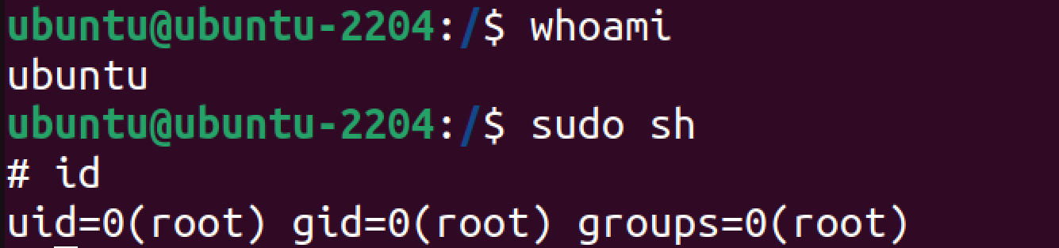
Current user’s information
Unix systems allow a single user to run processes for other users
Each process belong to the user that launched it, thus a single session may be associated with different users
We know how to use both whoami and id for checking this

Slide 26
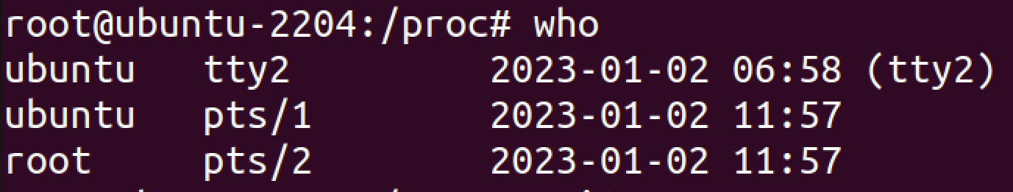
Users logged in the system
We can use who to list the users currently logged in the system
For each user we have its username, terminal type (tty or pty/s), login time
tty = teletypewriter terminal (directly connected to the device)
pty/s = pseudo-terminal device/slave (program emulated, e.g., ssh)

Slide 27
Users’ activity
We can check what user alice is doing by means of ps -u alice
An alternative to get the activities carried out by all the users is through w

Slide 28
Log of login and events
We can visualize the last login operations through last and lastlog
last shows the last logins
lastlog shows the last login per user
Administrators can also check authentication events through
cat /var/log/auth.log
The file contains failed access attempts (while last and lastlog only contains the successful ones)
E.g., call to ssh using the wrong password

Slide 29
Controllo della history
Il sistema tiene traccia all’interno di un file nascosto di tutti i comandi eseguiti dall’utente
Il file si trova nella home e tipicamente si chiama .history o .bash_history
Possiamo individuarlo con ls -a
La history può essere consultata con il comando history o leggendo il file nascosto
Attenzione: gli utenti possono cancellare la propria history con history -c

Slide 30
Using LSM to monitor events
If AppArmor or SELinux are set to auditing/permissive policy violations are not blocked
In any case, they are recorded in system logs and can be inspected
AppArmor: aa-logprof
SELinux: grep selinux /var/log/audit/audit.log
In this way LSM can be used as an advanced monitoring system

Slide 31
Intervenire sui processi degli utenti
If necessary we can also actively operate on users’ activities
I due comandi principali che possono esserci utili in questo caso sono kill e renice
kill (killall) serve per terminare un processo in esecuzione. Es. kill 1062
Più precisamente invia un segnale al processo <pid>. kill -L mostra l’elenco di tutti i segnali
renice serve a modificare il livello di priorità di un processo/utente/gruppo
renice -10 -p 1062 → imposta a -10 la priorità del processo 1062
renice -20 -u alice → imposta a -20 la priorità dei processi di alice
Ad ogni modo intervenire direttamente sui processi è sempre rischioso

Slide 32
Windows user management

Slide 33
Preliminaries
Windows OS are pretty different from Unix-like ones
In particular, user management and access policies are handled through GUI applications
This also leads to some significant differences between Windows versions
Since the look and feel changes, also the management apps may be different
The following applies to Windows 10 and there might be slight differences with other versions, e.g., Windows 11

Slide 34
Preliminaries: Windows FS structure
A typical installation of Windows 10 creates a boot partition
Usually located in C:\
The volume contains the following directory
\PerfLogs: may contain performance logs (but often empty)
\Program Files: programs for the current architecture
\Program Files (x86): programs for compatible architectures (e.g., 32-bit)
\ProgramData: programs’ data
\Users: users’ profiles data
\Windows: Windows system files

Slide 35
Preliminaries: Windows registry
The configuration and management of installed programs differs significantly between Windows and Linux
In Windows systems programs’ configurations are contained in a data structure called registry
Registry is a hierarchical, tree-like data structure (similar to a filesystem)
Every entry consists of a key (name), a type (type) and a value (data)
Registry entries can be shown through command regedit

Slide 36
Account type
The recent versions of the OS support 3 categories of accounts
Local account: traditional accounts
Domain account: accounts defined on an Active Directory network
Microsoft account: accounts directly managed through Microsoft Cloud
Local accounts can only access the machine where they are created and configured
They share no account information with other devices

Slide 37
Local accounts
Usually a fresh installation of Windows 10 generates 3 local accounts
Administrator: system administrator account
DefaultAccount: user account managed by the system
Guest: user account for guest access
Accounts are handled by the Security Account Manager (SAM)
Data are stored in C:\Windows\System32\config\SAM
Configuration entry in the registry under HKEY_LOCAL_MACHINE\SAM

Slide 38
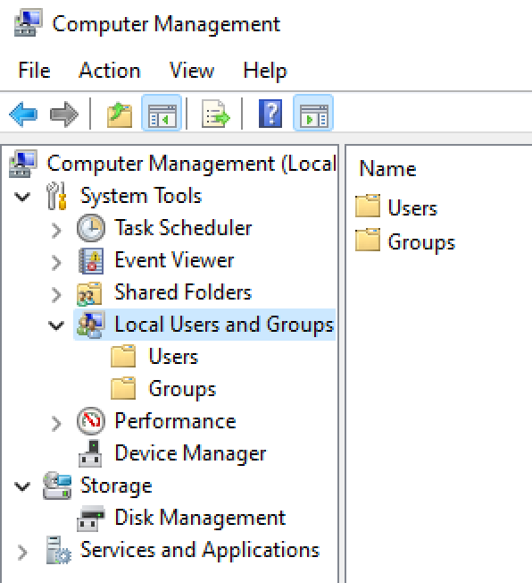
Creating a local account
Right click on start menu (or Super + X)
Computer Management
starts the Computer Management application
Local Users and Groups
Users
Lists the existing users
Right click on central panel → New User
Run user creation procedure

Slide 39
Modify a local account
Re-open the Computer Manager interface and double click on the user we want to modify
The configuration window has 3 tabs
General: contains general information of the account (e.g., full name)
Member of: lists the group (see next) the user is member of
Profile: allows to configure the user profile
Profile path: directory for the account configuration (by default is the user’s home)
Logon script: a batch file (.bat) to be executed at user’s login
Home path: User’s home folder (by default C:\Users\Username)

Slide 40
Local account management using PowerShell
The very same operations can be done via PowerShell
Disable-LocalUser: disables the account of a local user
Enable-LocalUser: enables a disabled account
Get-LocalUser: shows the list of existing accounts
New-LocalUser: creates a new local account
Remove-LocalUser: deletes an existing local account
Rename-LocalUser: renames an existing user
Set-LocalUser: modifies an existing local account

Slide 41
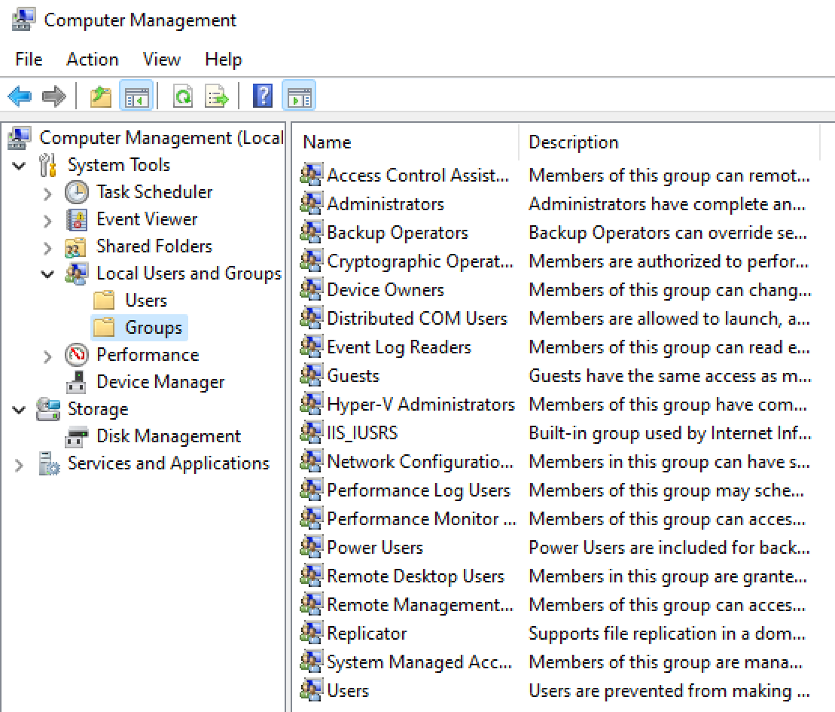
Local groups
During the installation, Windows creates many predefined groups
The list can be seen under the Computer Manager interface
The idea is that, when possible, existing groups should be used, avoiding the creation of new ones
Although this is not prohibited in general

Slide 42
Creation and management of local groups
The management of local groups resembles that of local users
Graphically through the Computer Manager interface
Via PowerShell with the commands:
Get-LocalGroup
New-LocalGroup
Remove-LocalGroup
Rename-LocalGroup
Set-LocalGroup
Add-LocalGroupMember
Get-LocalGroupMember
Remove-LocalGroupMember

Slide 43
Filesystem Windows
Windows 10 mainly supports two types of filesystem
File Allocation Table: old format, used for compatibility
New Technology FileSystem: format supported by default
The main limitation of the FAT format are in terms of
Security: FAT does not memorize files’ access permissions
Auditing: FAT does not record files’ access attempts
For these reasons it is better to focus on NTFS
Windows 10 includes a utility called convert to translates from FAT to NTFS

Slide 44
PowerShell: some commands
PowerShell is meant to replace the old command prompt and it (roughly) accepts the *nix commands’ syntax
cd: change directory (as in Linux)
md: create directory (alias for mkdir)
del: delete file or directory (alias for rm)
move: move file or directory (alias for mv)
dir: list files and sub-directories (alias for ls)
Hence, knowing the Linux commands is enough to use PowerShell quite proficiently

Slide 45
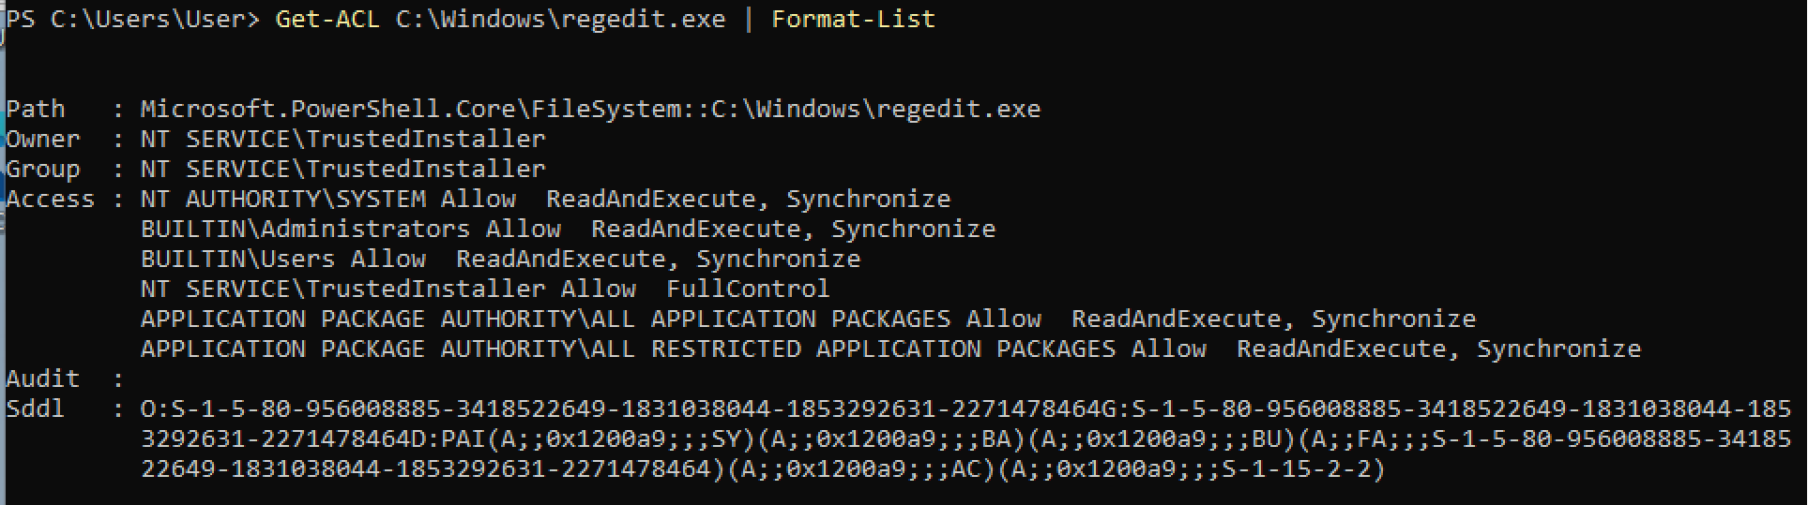
Access Control List Windows
Also Windows 10 implements ACL for defining access control rules
Inside DOS command prompt we can use icalcs
In PowerShell there are more intuitive and usable commands

Slide 46
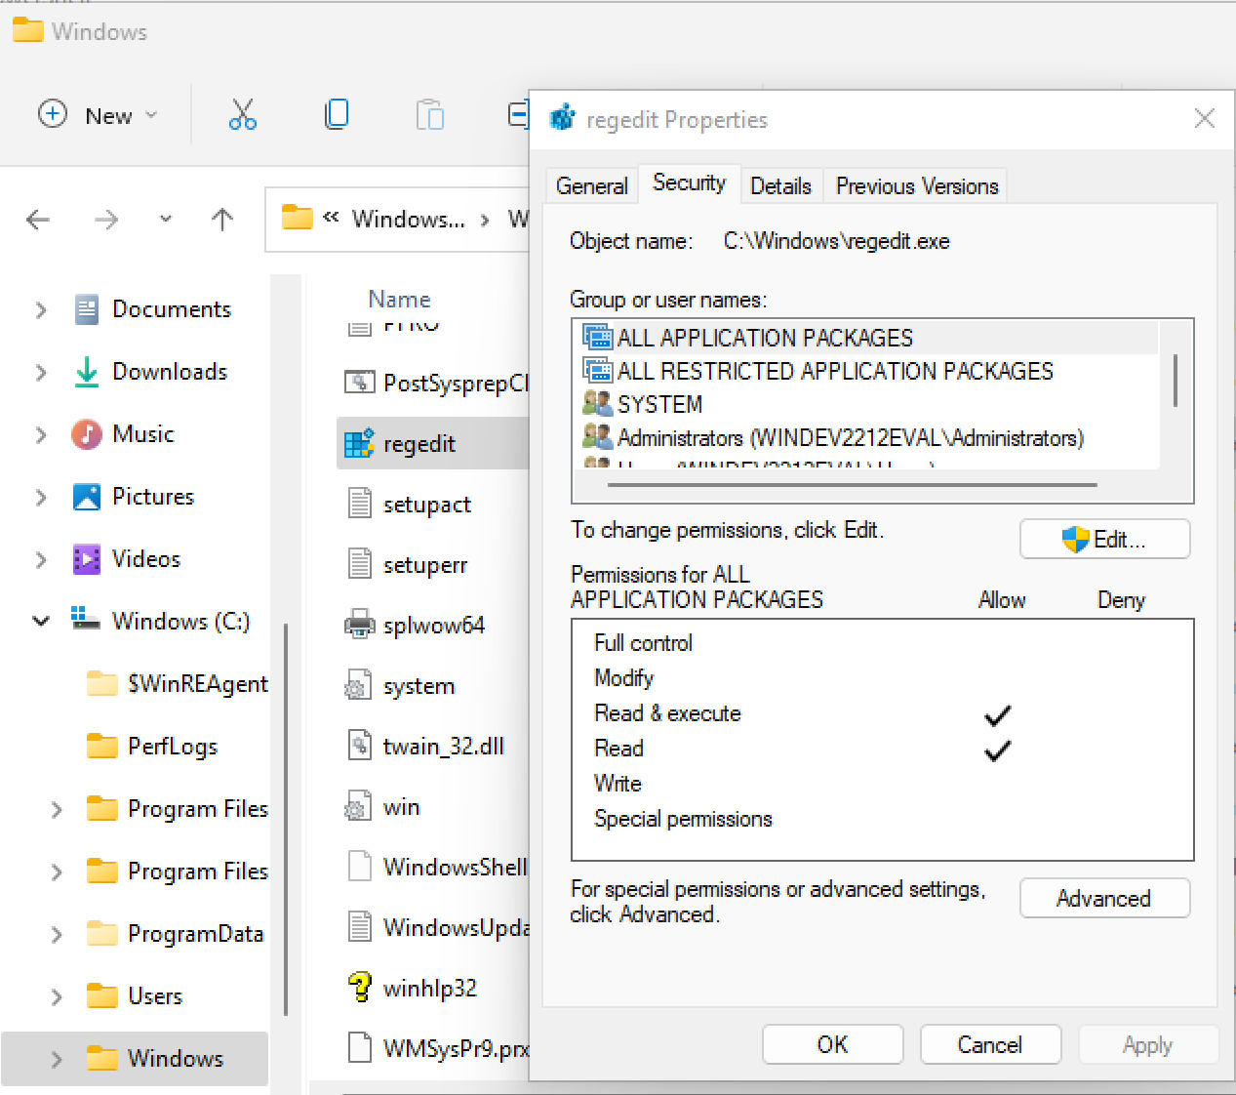
Permissions from resource explorer
We can also inspect access permissions from the GUI
From resource explorer →Right click on a file or directory →Properties
Inside Security tab there is the list of users and groups having access permissions
We can also inspect them one by one

Slide 47
File owner
As for Linux, also in Windows the owner gives permission to access her own files
However, in Windows there is a special permission that provides users with privileges substantially equivalent to those of the owner
Full Control
The Full Control permission subsumes all the other access permissions
A user having Full Control on a directory can eliminate its content, even when she has no permissions on them!

Slide 48
Users and groups permissions
Permissions can be assigned to both local users and groups
Permissions are evaluated following a cumulative reasoning
A user has all the permissions directly assigned to her AND all the permissions of all the groups she is a member of
For this reason there is a deny option when permissions are assigned
In general, deny rules have highest priority w.r.t. the allow rules
Conventionally, permissions are split in basic and advanced
basic: frequent and common usage permissions
advanced: all the others

Slide 49
Basic permissions
Basic permissions that we can assign to a file or directory are
Full Control: can do any operation (but cannot modify owners’ permissions)
Modify: can read, write and modify permissions
Read & execute: can read and run
Read: can read
Write: can write
Special permissions: flag denoting the existence of customized rules

Slide 50
Permissions inheritance
Is the mechanism for transferring the permissions settings of a directory to all the files and sub-directory it contains
Understanding how the permission inheritance works is extremely important as the actual permissions result from a composition of those directly assigned and the inherited ones
E.g., if a directory assigns Write so that user Alice inherits it and we create a file inside the directory such that Alice has the Read permission, Alice will be authorized to both read and write
Also, changing a directory’s permissions will impact on its content

Slide 51
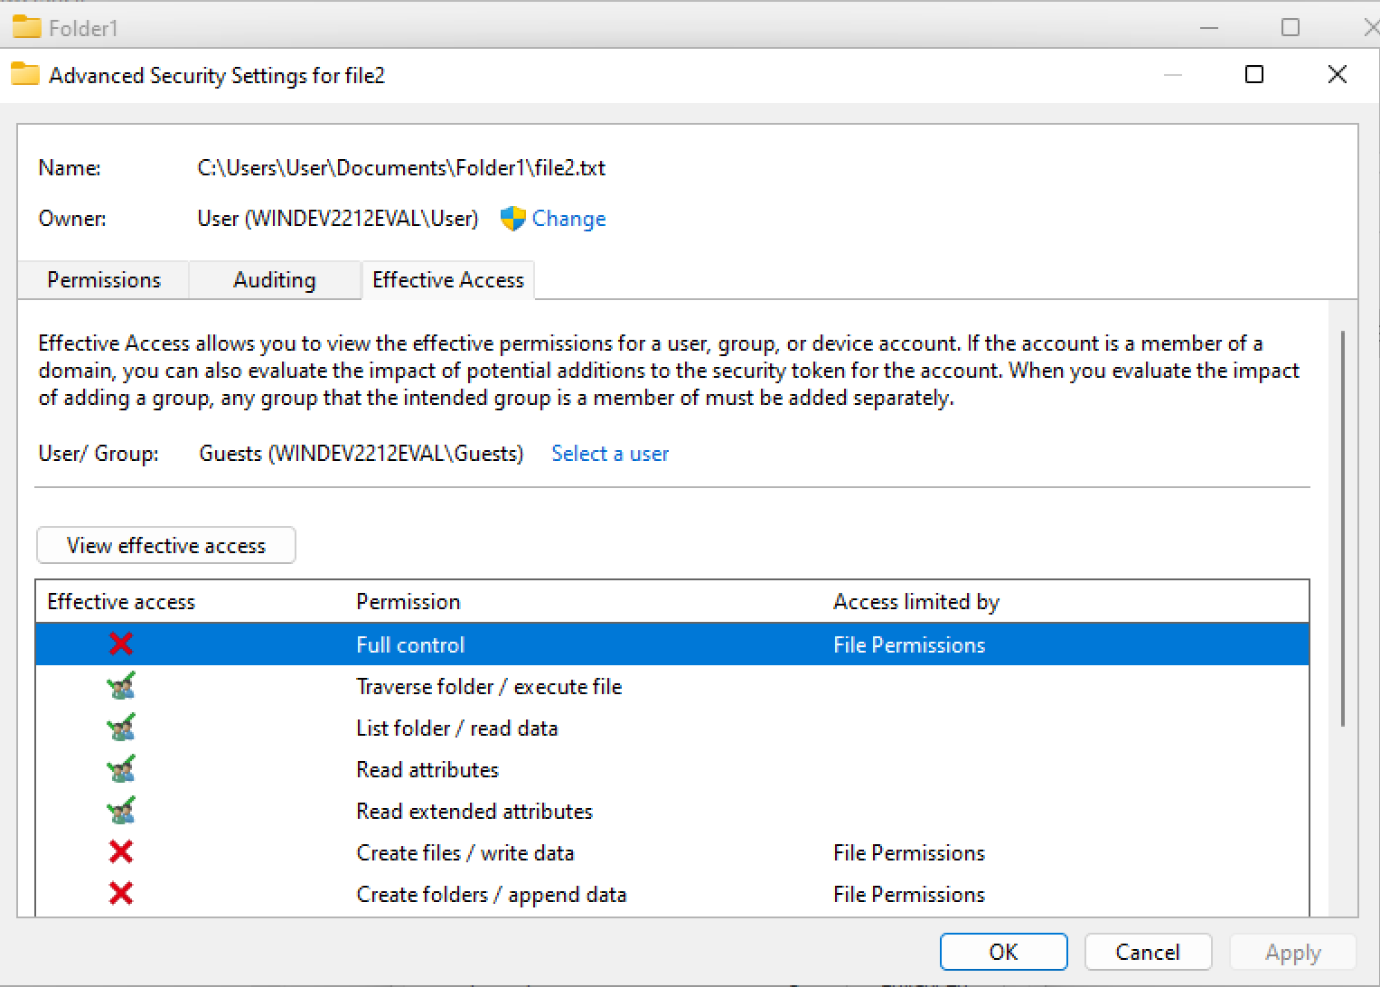
Actual permissions
We can inspect the actual permissions assigned to a user by checking the properties of a file
Security → Advanced → Effective Access (selecting a user or a group)

Slide 52
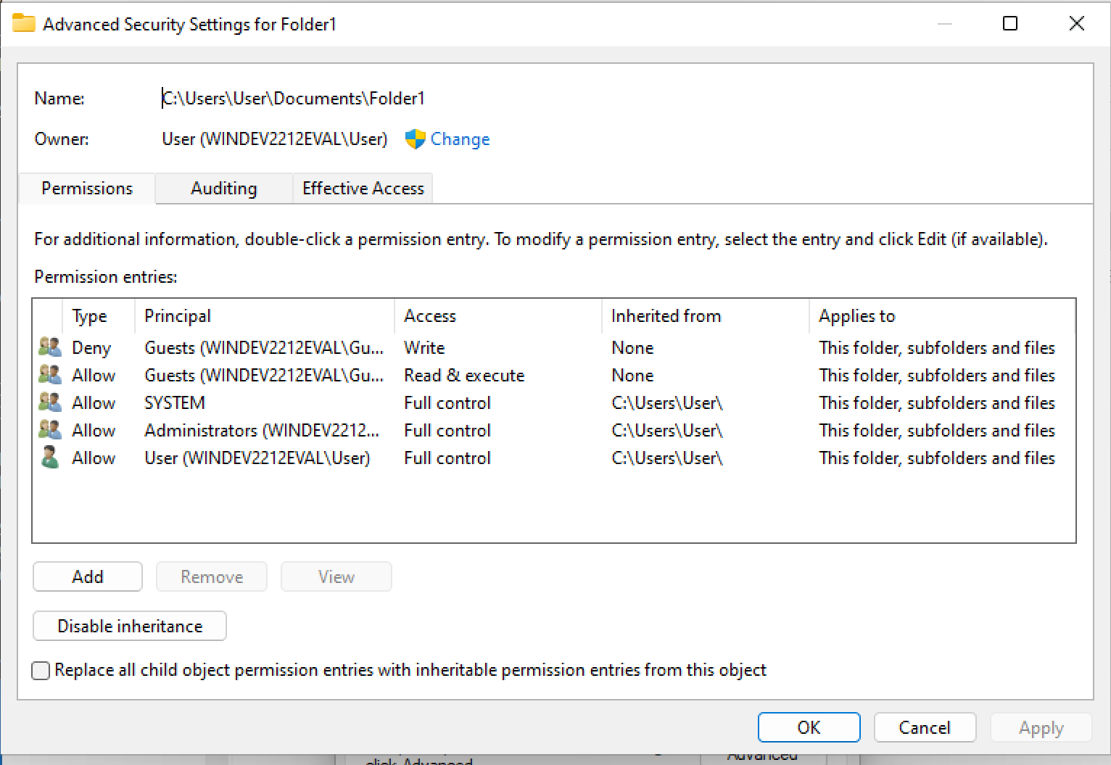
Managing permissions’ inheritance
We can inspect the rules that control the inheritance system
Properties→Security→Advanced
For each rule we can check if it was inherited (and from where) as well as whether it is transferred

Slide 53
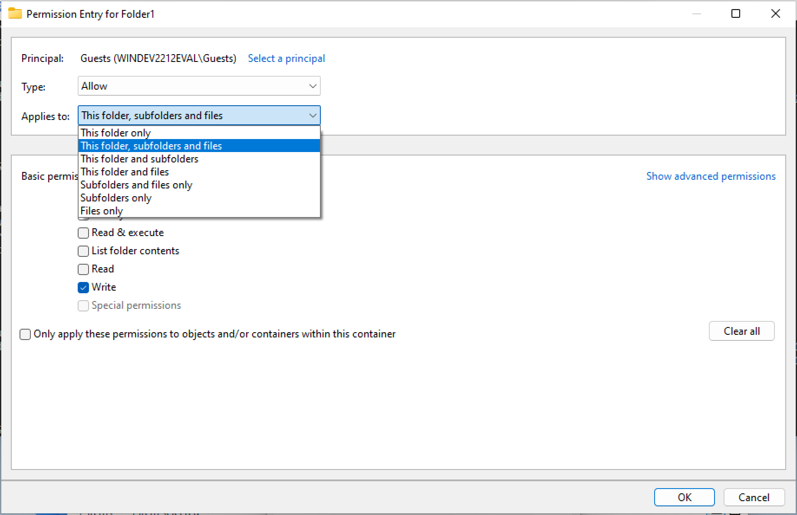
Managing permissions’ inheritance
If we need to customize the way permissions are inherited we can do it as follows
Double click on the rule to modify
Then select the permissions we want to assign and also the way they are inherited

Slide 54
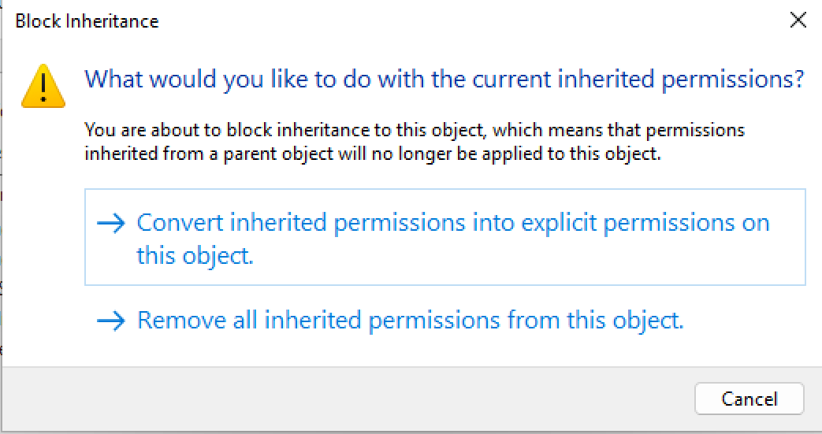
Disable permissions’ inheritance
Again from advanced options screens, we can disable permissions’ inheritance
Since this may lead to cascade effects on the entire filesystem tree, Windows also proposes to convert inherited permissions into explicit ones
In this way permissions are still applied an must be removed manually

Slide 55
Permissions of moved files
When a file or directory is copied the permissions of the destination directory are applied (similarly to the creation of a new file)
If the destination filesystem does not support permissions (e.g., FAT32) they are just lost
When elements are moved within the same NTFS partition, explicit access rules are also moved, however the destination directory rules are inherited
Caveat: some commands do not transfer permissions (e.g., Copy) while others do with the proper parameters (e.g. Xcopy /o)

Slide 56
Group policy configuration
Windows permits to define and apply group policies (Group Policy Object – GPO) on devices
GPO can be defined at organizational level and distributed through Active Directory, but they can also be locally defined on each device (Local GPO)
GPO may affect several aspects of the device’s usage and they are defined and managed through the local policy editor Secpol.msc

Slide 57
Defining an auditing policy
The auditing policy allows to record some critical events in the log
E.g., Configuring an auditing policy for the logon of users
Start (Super key) → Type “Secpol” → Select Local Security Policy
Local Security Policy → Local Policies → Audit Policy
Double click on Audit Account Logon Events
Select Success and Failure

Slide 58
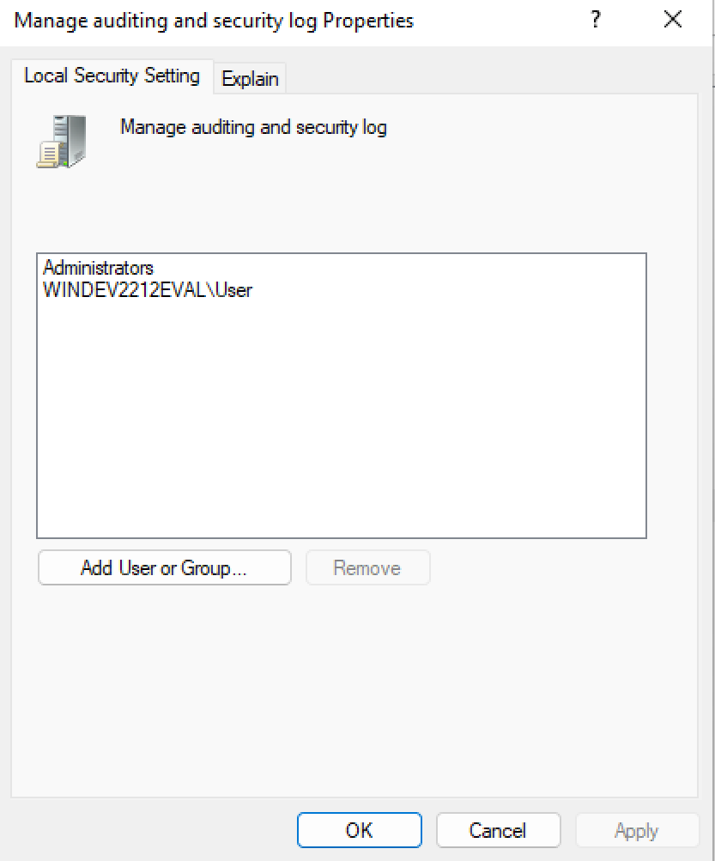
Defining privileges for users and groups
Device access policies can also be managed to define fine-grained rules
E.g., To configure the auditing policy
Start → Type “Secpol” → Local Security Policy
Local Security Policy → User Rights Assignment
Double click on Manage Auditing and Security Log
Add User to the list of users and groups
From now on User’s activity will be logged

Slide 59
Security Policy for user account
Local policies may also be defined for the account management
E.g., Configure a policy for password management
Start → Type “Secpol” → Local Security Policy
Local Security Policy → Password Policy
Double click on Enforce Password History
Set password history (e.g., 5)
Double click on Maximum Password Age
Set a number of days before password expiration

Slide 60
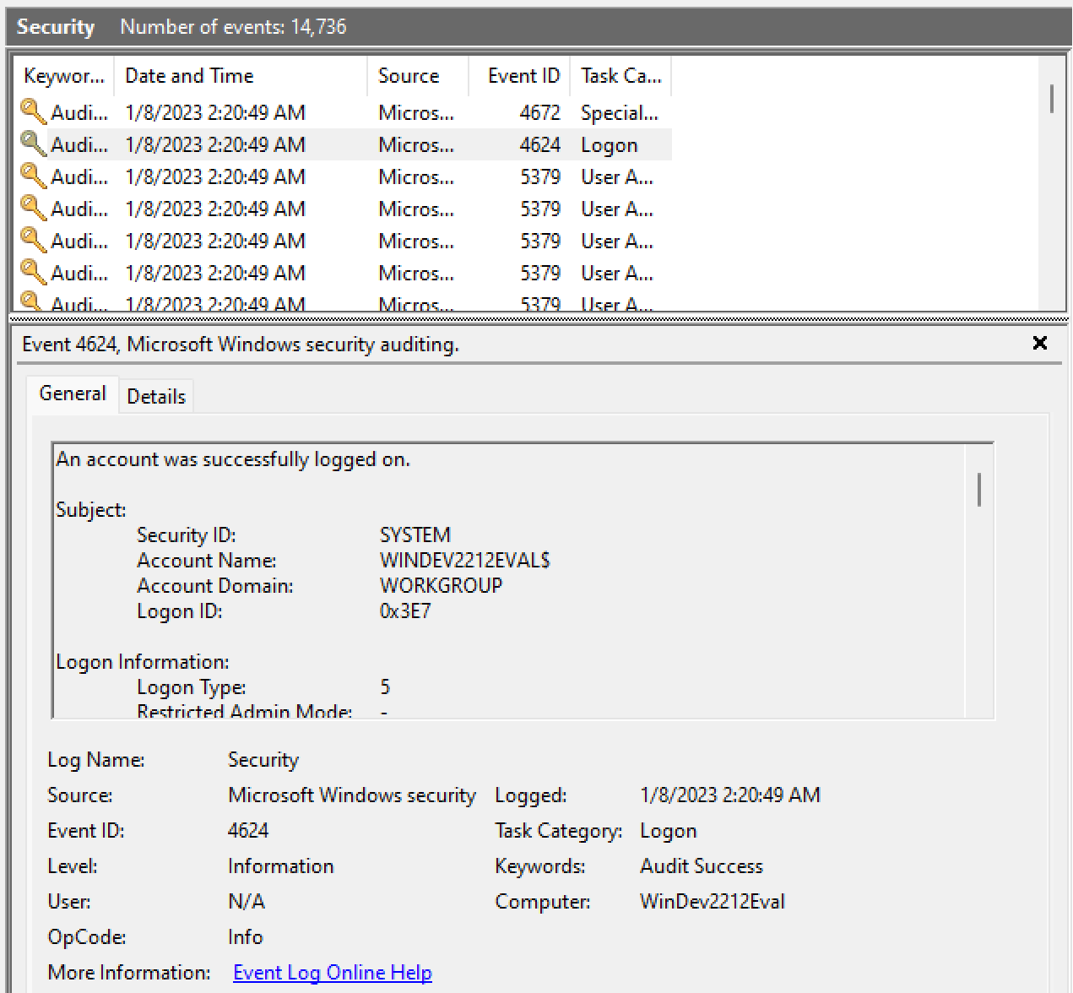
Accessing the events log
To inspect the events recorded in the system log, we must use the Event Viewer
Start (or Super key) → Event Viewer
Form Event Viewer interface → Windows Logs → Security Log
This includes events generated due to the applied Group Policy Objects (GPO)

Slide 61
Managing and debugging the policies
As already said, managing the policies may become complex
The effects due to a new policies are not easy to anticipate and violations cannot always be mapped back to a specific policy failure
Windows 10 includes a dedicated tool: Resultant Set of Policy (rsop.msc)
Start (or Super key) → rsop (executable in C:/Windows/System32)
The tool shows the GPO defined in the system and displays a report
A similar operation can be done through PowerShell with gpresult /r
E.g., gpresult /r /scope:user
Shows the GPO applied to a specific user

Slide 62
Conclusion
Linux and Windows policies may be more complex than expected
During vulnerability assessment and exploitation we may have a look at them
Managing complex rules leads to mistakes and poor configurations
Weaknesses can be found in the way permissions are managed and policies are defined

Slide 63
End

